Slide 1


Slide 2


Slide 3




BetterCrypto⋅org
Applied Crypto Hardening
David Durvaux
Aaron Kaplan
Brussels, 9th June 2014

Slide 4
Recording…
[ADD DISCLAIMER HERE]

Slide 5
Who
Wolfgang Breyha (uni VIE),
David Durvaux (CERT.be),
Tobias Dussa (KIT-CERT),
L. Aaron Kaplan (CERT.at),
Christian Mock (coretec),
Daniel Kovacic (A-Trust),
Manuel Koschuch (FH Campus Wien),
Adi Kriegisch (VRVis),
Ramin Sabet (A-Trust),
Aaron Zauner (azet.org),
Pepi Zawodsky (maclemon.at),
New contributors:
IAIK,
A-Sit

Slide 6
Agenda
Pieces of History
Introduction to BetterCrypto project
Cryptography in a nutshell
Practical Settings
Testing
Demo
Conclusion

Slide 7

Pieces of History

Slide 8
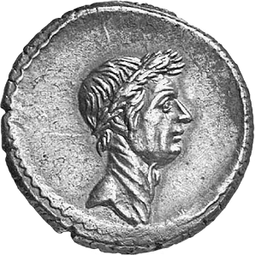
Caesar
Vigenère Cipher

Slide 9
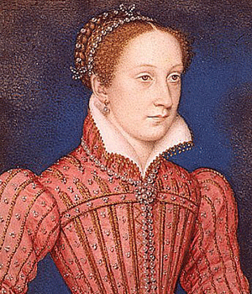
Mary Queen of Scots
Trial against Queen Elizabeth
Was executed after her code was broken (1587)

Slide 10
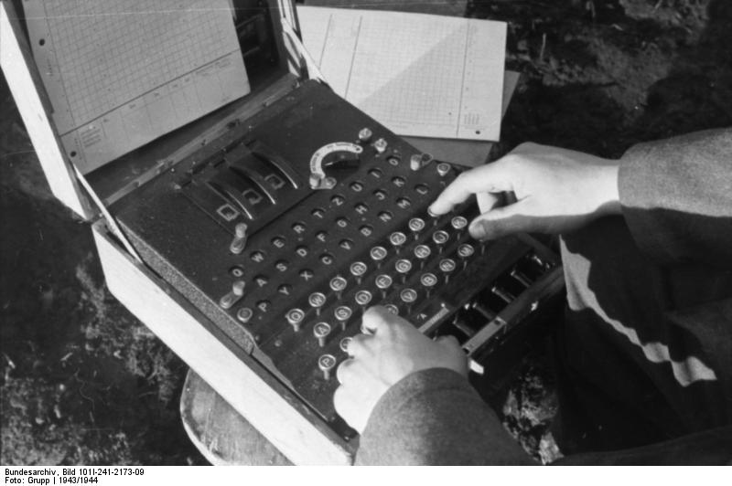
Enigma
Secret in code book

Slide 11
BetterCrypto

Slide 12
Why?
Crypto is cryptic
A lot of difficult concepts
A lot of algorithms
A lot of parameters
…

Slide 13
The Idea
Really difficult for systems administrators
A “cookbook” can help!
That’s BetterCrypo

Slide 14
That’s not…
A crypto course
A static document

Slide 15
In short
Community effort to produce best practices
Continuous effort
Mixed expertises
Open to comments / suggestions / improvements

Slide 16
2 parts
First part = configurations
The most important part
Cover as many tools as possible
Second part = theory
Explain and justify choose we made
Transparency

Slide 17
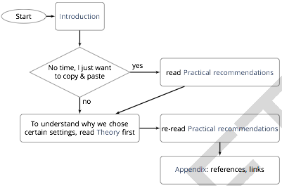
How to use?

Slide 18
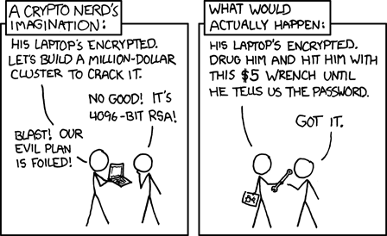
Crypto in a nutshell

Slide 19
Goals
2 types of goals:
protect the contact of the message
identify the author
Can be combined

Slide 20
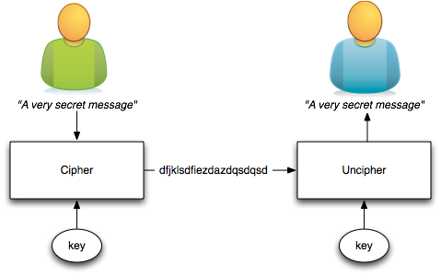
Symetric Ciphering
The key is shared

Slide 21
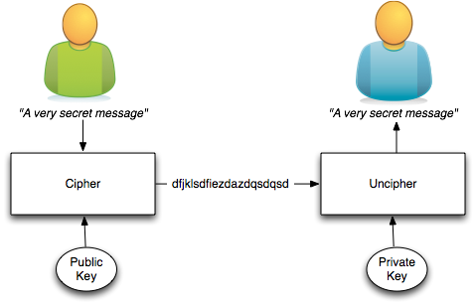
Asymetric Ciphering
Public key is published
Private key HAS to be secured

Slide 22
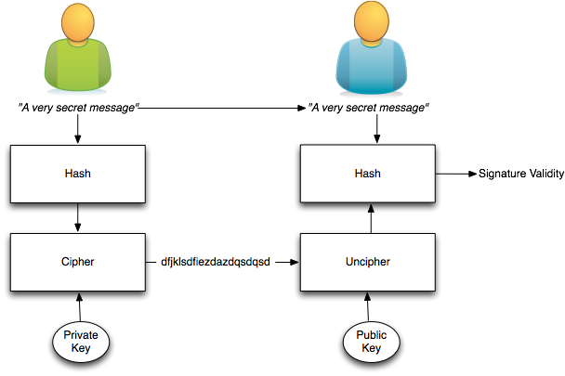
Signing
Author identity is proved

Slide 23
The asymmetric magic
RSA “formula” :
with
c which is the ciphertext
m is the cleartext message
e and n are the public key
Uncipher with
d being the private key

Slide 24
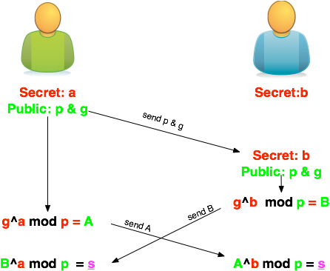
Diffie-Helleman
How to share a secret key?

Slide 25
Ephemeral Diffie-Helleman
Regular mode
Public and private keys are kept
Ephemeral mode
New keys are generated each time
By one of the parties at least

Slide 26
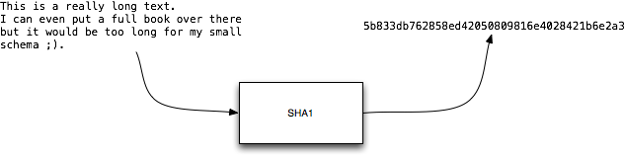
Hashing
Take long piece of data and produce a probably unique signature
Probability of collision for SHA1:
1 over 1461501637330902918203684832716283019655932542976

Slide 27
ECC
Elliptic curve cryptography (ECC)
Finding the discrete logarithm of a random elliptic curve element
Only knowing a base point
Assumed to be infeasible
Reduced key length

Slide 28
Some thoughts on ECC
Currently this is under heavy debate
Trust the Math
“Nothing Up My Sleeve Numbers”
eg. NIST P-256 (http://safecurves.cr.yp.to/rigid.html)
Coefficients generated by hashing the unexplained seed c49d3608 86e70493 6a6678e1 139d26b7 819f7e90.
Might have to change settings tomorrow
Most Applications only work with NIST-Curves

Slide 29
SSL
[Explain]

Slide 30

Forward Secrecy-Motivation:
Three letter agency (TLA) stores all ssl traffic
Someday TLA gains access to ssl-private key (Brute Force, Physical Force)
TLA can decrypt all stored traffic

Slide 31
Perfect Forward Secrecy
DHE: Diffie Hellman Ephemeral
Ephemeral: new key for each execution of a key exchange process
SSL private-Key only for authentication
Alternative new ssl private key every x days months
Pro:
Highest Security against future attacks
Contra:
Elliptic Curve
Processing costs

Slide 32
Stream vs Block Cipher
Stream cipher
Generate an “infinite” key stream
Difficult to correctly use
Re-use of keys
Faster
Block cipher
Cipher by block with padding
Could include integrity protection

Slide 33
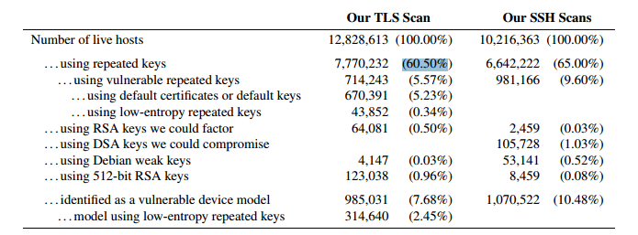
RNGs
RNGs are important.
Nadia Heninger et al / Lenstra et al
Entropy after startup: embedded devices

Slide 34
RNGs
Weak RNG
Dual EC_DRBG is weak (slow, used in RSA-toolkit)
Intel RNG ? Recommendation: add System-Entropy (Network). Entropy only goes up.
Tools (eg. HaveGE http://dl.acm.org/citation.cfm?id=945516)
RTFM
when is the router key generated
Default Keys ?
Re-generate keys from time to time

Slide 35
Some algorithms
Symetric Ciphering
DES / 3DES
AES (Rijndael)
Camellia
Asymetric Ciphering
RSA
PGP (GPG)

Slide 36
Some algorithms
Hash
SHA1
SHA256
SHA512
Key Exchange
Diffie Helleman

Slide 37
Algorithm vs Implementation!
Heartbeat

Slide 38
Heartbeat
/* Enter response type, length and copy payload */
*bp++ = TLS1_HB_RESPONSE;
s2n(payload, bp);
memcpy(bp, pl, payload);
payload (pl) and payload_length (payload) are controlled by attacker
memcpy will copy a part of the victim memory to the reply…

Slide 39
Cost of encryption
$ time openssl enc -e -a -aes-128-cbc -in ./rfc791.txt \ -out /tmp/rfc.aes -k "Super Key" -S 01EF
real 0m0.014s
user 0m0.004s
sys 0m0.003s
$ time gpg -a -u 57AB3358 -r 77659F3E -e ./rfc791.txt
real 0m0.069s
user 0m0.048s
sys 0m0.008s
GPG is 4,93 time slower!
Notes:
$ openssl enc -a -aes-128-cbc -in /tmp/demo.msg -out /tmp/demo.aes -k "Super Key" -S 01EF –e
$ openssl enc -a -aes-128-cbc -out /tmp/demo-back.msg -in /tmp/demo.aes -k "Super Key" -S 01EF –d
GPG key of 8192 bits vs 128 bits AES encryption
Demo file is the IP RFC ;)

Slide 40
Keylengths
On the choice between AES256 and AES128: I would never consider using AES256, just like I don’t wear a helmet when I sit inside my car. It’s too much bother for the epsilon improvement in security.”
— Vincent Rijmen in a personal mail exchange Dec 2013

Slide 41
Keylengths
http://www.keylength.com/
Recommended Keylengths, Hashing algorithms, etc.
Currently:
RSA: >= 3248 bits (Ecrypt II)
ECC: >= 256
SHA 2+ (SHA 256,…)
AES 128 is good enough

Slide 42
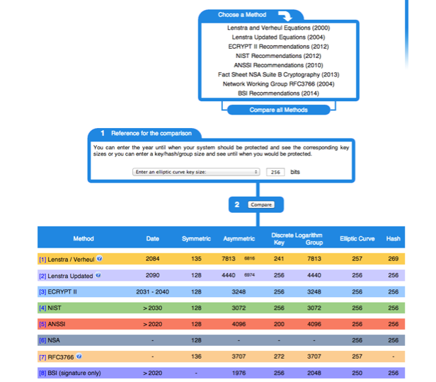

Slide 43
BetterCrypto CipherSuite
2 cipher suites
version A
stronger
less supported client
version B
weaker
more “universal”

Slide 44
Some general thoughts on settings
General
Disable SSL 2.0 (weak algorithms)
Disable SSL 3.0 (BEAST vs IE/XP)
Enable TLS 1.0 or better
Disable TLS-Compression (SSL-CRIME Attack)
Implement HSTS (HTTP Strict Transport Security)

Slide 45
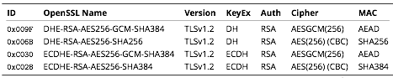
Cipher Suite A
TLS 1.2
Perfect forward secrecy / ephemeral Diffie Hellman
Strong MACs (SHA-2) or
GCM as Authenticated Encryption scheme

Slide 46
CiperSuite B
TLS 1.2, TLS 1.1, TLS 1.0
Allowing SHA-1

Slide 47
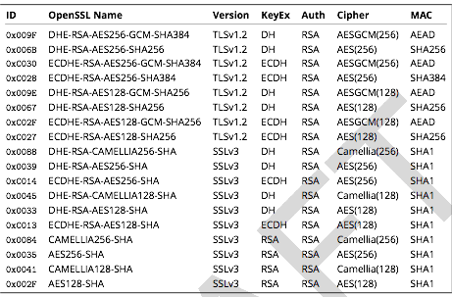
Cipher Suite B

Slide 48
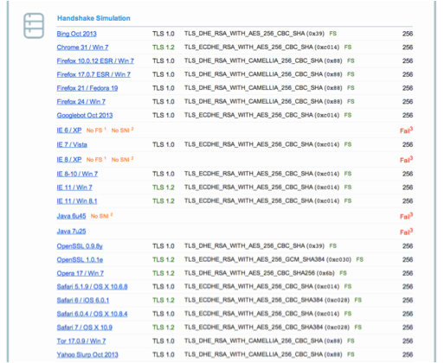
Compatibility (B suite)

Slide 49

Practical Settings

Slide 50
Tools covered
Webservers
Apache
lighttpd
nginx
Microsoft IIS

Slide 51
Tools covered
SSH
Open SSH
Cisco ASA
Cisco IOS

Slide 52
Tools covered
Mail servers
Dovecot
cyrus-imapd
Postfix
Exim

Slide 53
Tools covered
VPN
IPSec
CheckPoint Firewall-1
OpenVPN
PPPTP
Cisco ASA
OpenSWAN
tinc

Slide 54
Tools covered
PGP/GPG
IPMI/ILO
Instant Messaging
ejabberd
OTR
Charybdis
SILC

Slide 55
Tools covered
Database systems
Oracle
MySQL
DB2
PostgreSQL

Slide 56
Tools covered
Proxy
squid
Bluecoat
Pound
Kerberos

Slide 57
Mail Encryption
GPG / PGG
[ a little bit over there ]

Slide 58
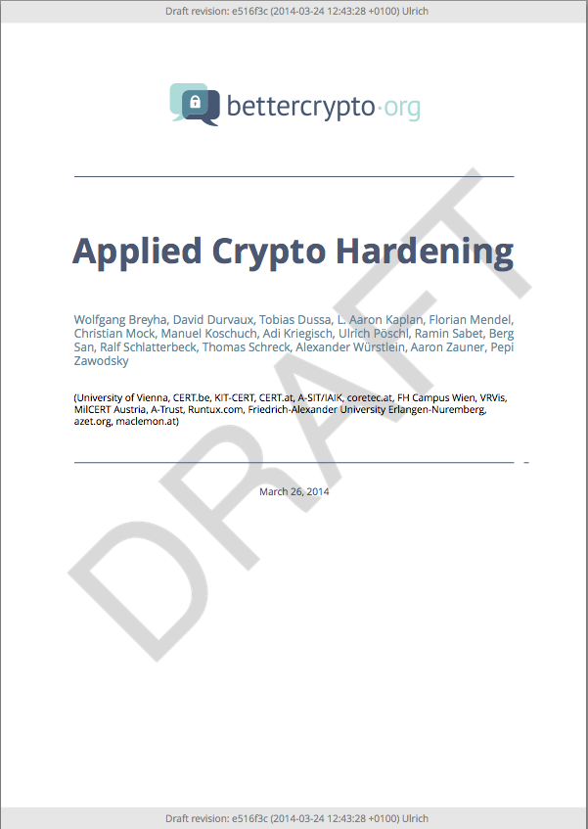
Let’s have a look

Slide 59
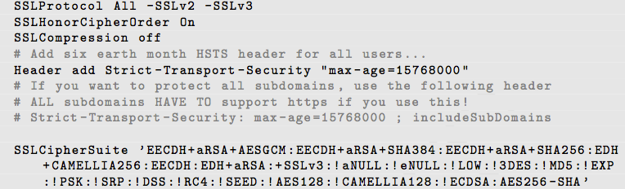
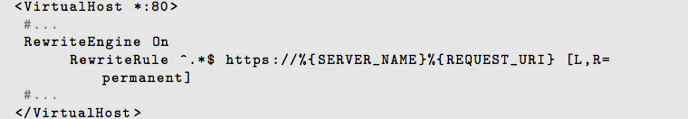
Apache
Selecting cipher suites:
Additionally:
Aaron

Slide 60
Testing

Slide 61
How to test? - Tools
openssl s_client (or gnutls-cli)
ssllabs.com: checks for servers as well as clients
xmpp.net
sslscan
SSLyze

Slide 62
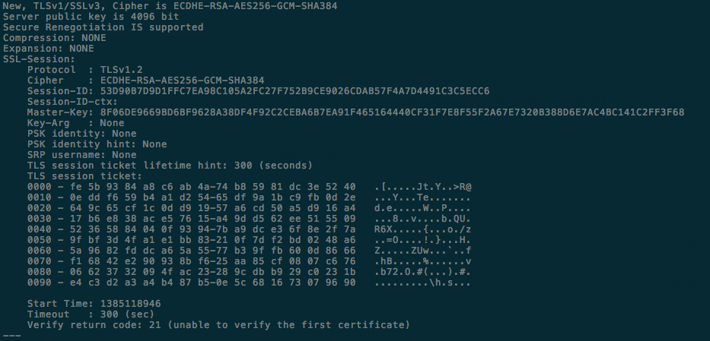
Tools: openss s_client
openssl s_client -showcerts –connect git.bettercrypto.org:443

Slide 63
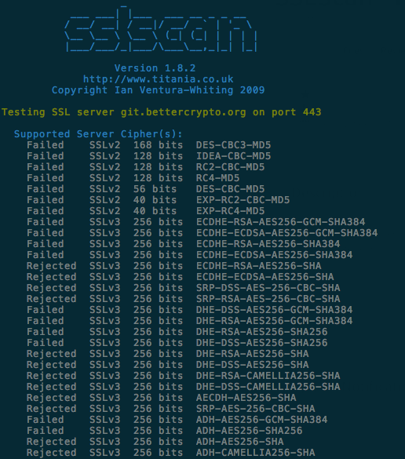
Tools: sslscan

Slide 64
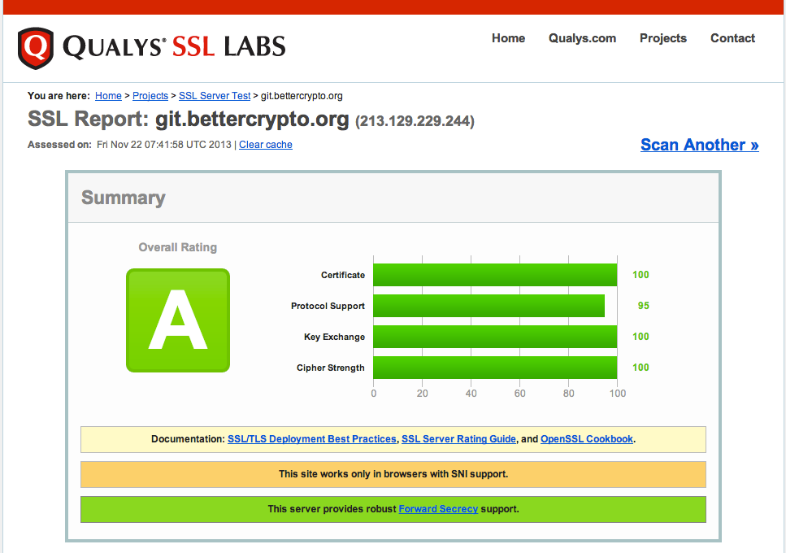
Tools: ssllabs

Slide 65
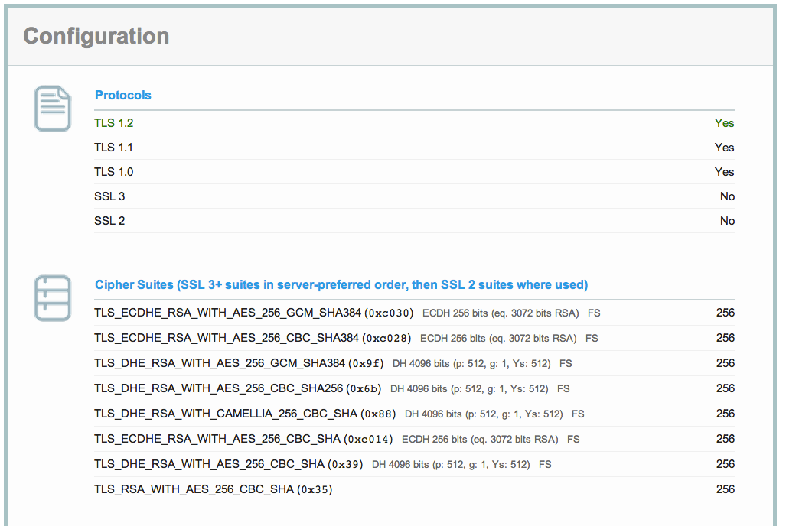
ssllabs (2)

Slide 66
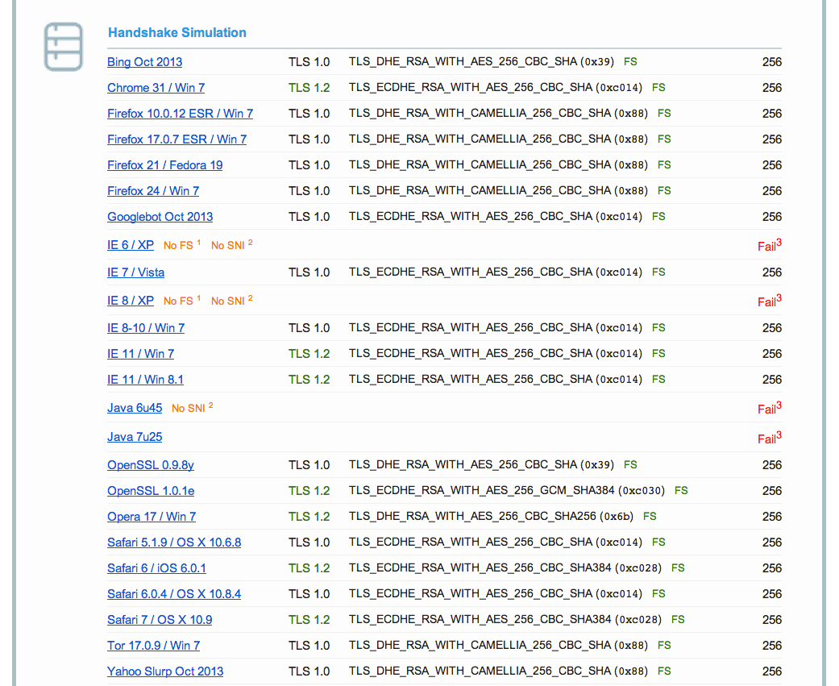
Ssllabs (3)

Slide 67
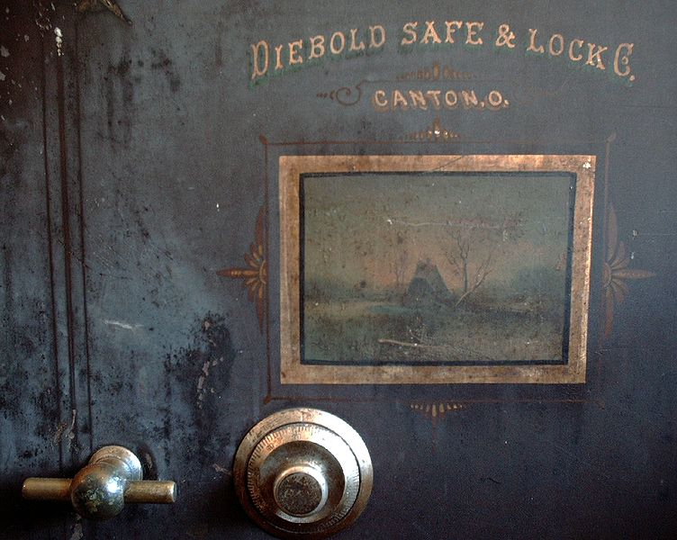
Demo

Slide 68
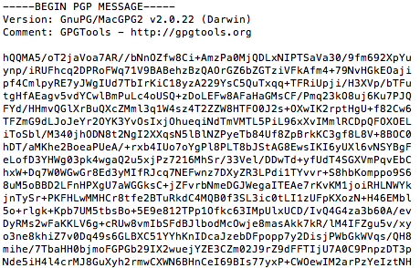
GPG - Ciphering
echo "This is a really secret" \ | gpg -a -u <your id>-r <his id> -e

Slide 69
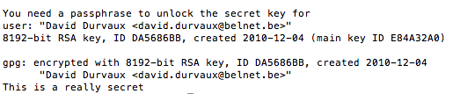
GPG - Unciphering
Let’s save the ciphered text to msg.asc
Then uncipher…
gpg -d msg.asc

Slide 70
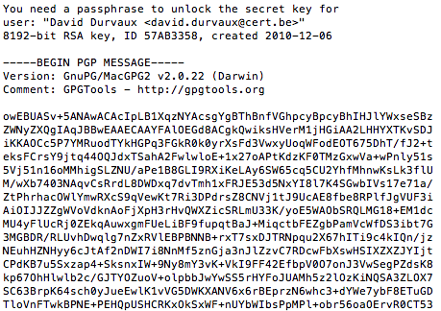
GPG - Signing
echo "This is a really secret" \ | gpg -a -u <your id>-r <his id>-s

Slide 71
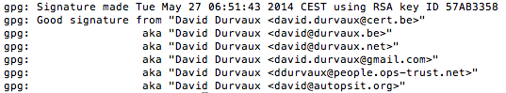
GPG – Check Signature
gpg --verify sig.asc
Differents way to sign / verify:
https://www.gnupg.org/gph/en/manual/x135.html
Other techniques
Clearsigned Documents
Detached Signatures

Slide 72
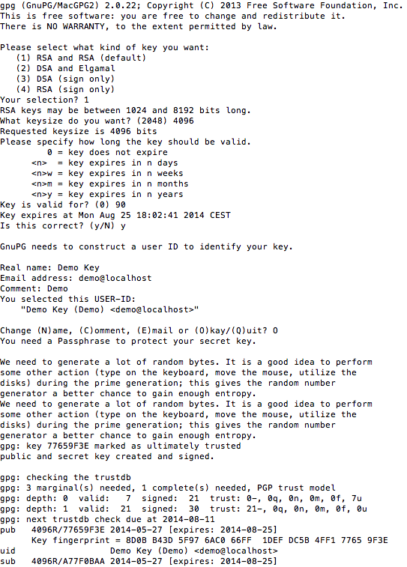
GPG Key generation
gpg --gen-key
Kind of Key
Keylenght
Expiration Period

Slide 73
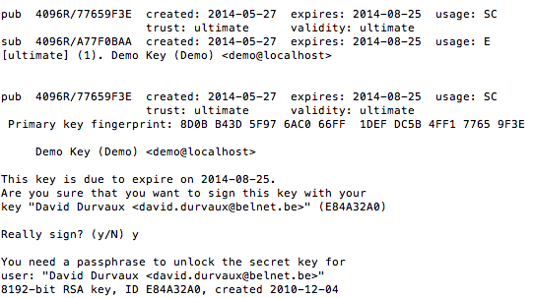
GPG – Key signing
gpg --sign-key -u <your ID> <his id>

Slide 74

GPG – Let’s do it!
Let’s do a key party!

Slide 75
GPG – Sending key
gpg --send-keys <key id>

Slide 76
GPG - Integration
Enigmail (Thunderbird)
GPGMail (Apple Mail)
Symantec PGP
…

Slide 77
Other nice user tools
TrueCrypt
KeePass

Slide 78
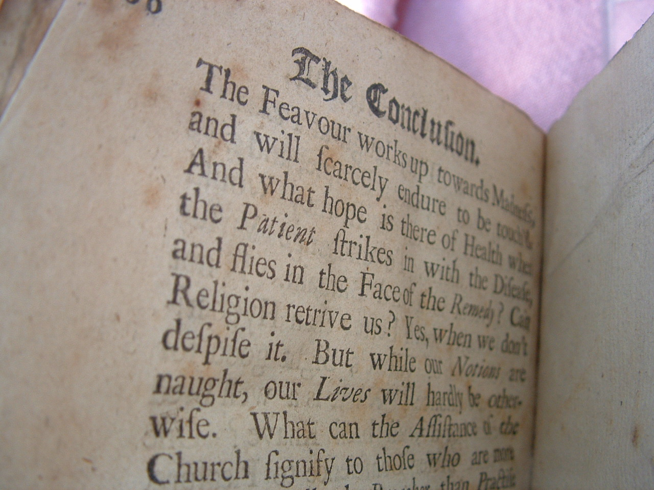
Conclusion

Slide 79
Futur / Idea
Configuration Generator (online)
Other tools
Other protocols

Slide 80
Current state as of 2014/05/31
Solid basis with Variant (A) and (B)
Public draft was presented at the CCC
Section „cipher suites“ still a bit messy, needs more work
Need to convert to HTML

Slide 81
How to participate
We need: cryptologists, sysadmins, hackers
Read the document, find bugs
Subscribe to the mailing list
Understand the cipher strings Variant (A) and (B) before proposing some changes
If you add content to a subsection, make a sample config with variant (B)
Git repo is world-readable
We need:
Add content to an subsection from the TODO list → send us diffs
Reviewers!

Slide 82
Thanks you!
BetterCrypto.org
https://git.bettercrypto.org/ach-master.git
http://lists.cert.at/cgi-bin/mailman/listinfo/ach
Contact
aaron@XXX.org — [TWITTER]
david@autopsit.org — @ddurvaux

